Slide 1
ENSE 374, Milestone 5
Software Group B
Avery, Jiahao, Jinkai, Mckenzie, Nick, Renz
December 6th, 2018

Slide 2
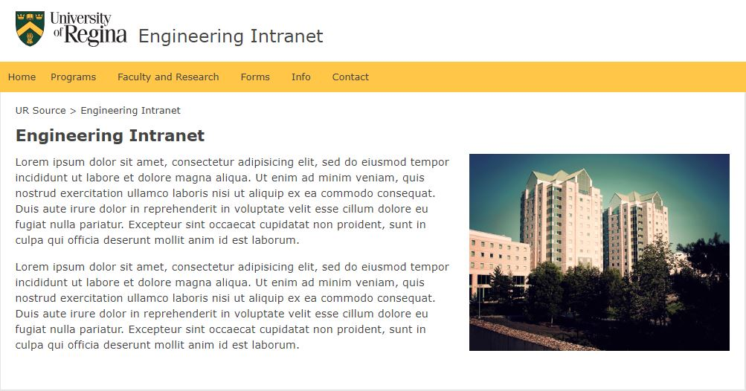
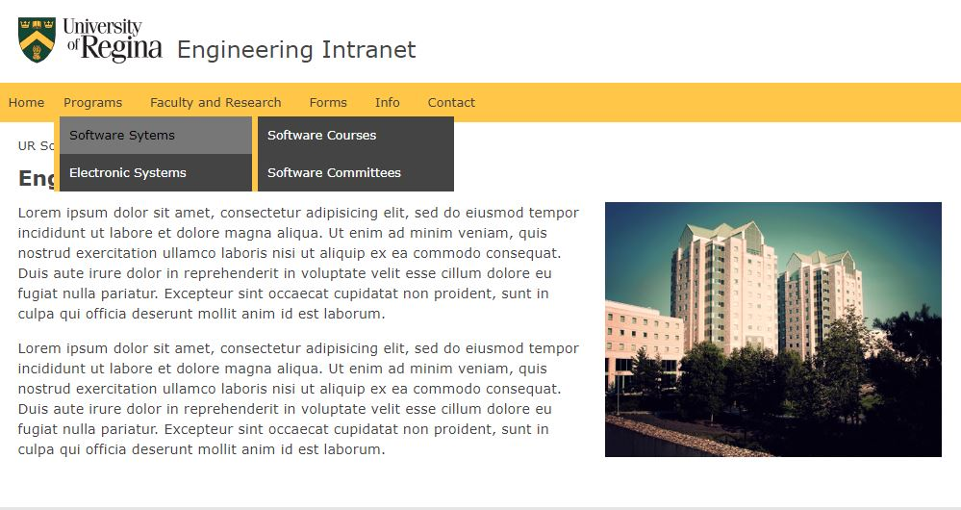
Revised Content Strategy
Removed sidebar use and opted for search bar
Removed form and faculty content from Programs
Changed homepage from having dynamic content
Notes:
We have screenshots of our initial navigation:
From our initial Lo-Fi prototypes we changed some aspects of our navigation and pages for easier use.
Under navigation for programs we chose to have only Courses and Committees, this is so no links are duplicated which could cause issues in the future.
We removed the sidebar due to potential complexity for users and implemented a search bar to search by key word.
This is not our final content strategy but some notable points of our initial cascade proposal.

Slide 3
Usability evaluation discussion
Pre-task questionnaire findings/analysis
1. What are your initial thoughts of the site?
-Simple and clear navigation overall
-Prevented lots of clicks to find files
-Consider committee as a separate navigation bar/page
2. What do you think of the headings and navigation?
-Major thing was to consider as a different page
-Could be a bigger in terms of dropdown contents
Notes:
Jiaohao -> Pre-task:
What are your initial thoughts of the site?
Both commented on the simple initial design and appreciated the simple navigation through dropdowns which prevents a lot of unnecessary clicks. Both noted Committees may be moved from program section and considered as a separate navigation bar or page. In general, keep a simple and clear navigation strategy for the website.
What do you think of the headings and navigation?
The major thing to be mentioned by Robin was considering committee as a different page. Lastly, Dropdowns could be a little larger for viewing purposes, this would have to be looked into for implementation.

Slide 4
Usability evaluation discussion
Task/Post-Task questionnaire findings/analysis
What are your suggestions to improve this?
- Add a dedicated page for committees
- Divide faculty and research into their own individual pages
- The proposed side navigation bar as well as the search bar will improve organization and structure
How does this compare to what is currently done?
- The delivered design fulfills a more efficient and intuitive approach
Notes:
Renz & Mckenzie -> Task and Post-task questions
In general, the task/post-task questionnaire boiled down to the following questions for each page we have delivered:
The questions were: A task, what are your suggestions to improve this, and how does this compare to what is currently done?
The various tasks were: Find the course page for 374, find the forms page, and find safety policies.
What are you suggestions to improve this?
Course Task:
- Add a Dedicated Committees Page :
- Remove its current position under program as a dropdown option
- Committees is a much bigger topic and goes across programs
- Fewer clicks for navigating context within programs
- Less confusion
Forms Task:
- Side Navigation Bar & Search Bar :
- Less clicks
- Efficient / quicker navigation
General
- Separate Faculty and Research :
- The faculty page contains abundant information (is okay)
- Research Interests, contact, photos, etc
- A dedicated research page
- on-going research, laboratory rooms, etc
How does this compare to what is currently done?
- Proposed design has a more logical structure
- Intuitive — things are where you would think it would be
- More efficient
- With the addition of Navigation bars and Search bars the proposed design gets an increase in efficiency with leads to an easier workflow.

Slide 5
Revisions and changes
Moved committees to the main navigation bar
Allowed courses to become the main index page
Implemented a potential side bar under forms
Large amount of CSS and HTML that could be challenging to some users
Notes:
Overall the questionnaire comments were positive which was helpful, however there were a few navigation and content changes we made.
We moved committees from being separated by program to the main navigation bar
this allowed courses to become the main index page under each program reducing the number of clicks needed
We implemented a potential side bar under forms as an example, however this required a fair amount of CSS and HTML that a nontechnical user might be uncomfortable with and have problems changing. This would have to be tested and confirmed again later.
We also separated Faculty and Research as Requested
Updated some content on homepage and courses to be more descriptive

Slide 6
Demo
Notes:
Sidebar under Forms
Search bar in Courses, Forms, Safety Policies
Updated main navigation bar
Notes:
Key Elements: Courses
Forms
Safety
Contact

Slide 7
Discussion of next steps
Discuss any gaps in your proposal
Only the administration tested the site
Security and Database code isn’t implemented
Search functions don’t work without the backend support
Do you envision hurdles in your implementation if your proposal is selected for trail?
Potential backend work
Security controls
Notes:
Nick
One of the biggest gaps in our proposal has is we only had administration staff use the site and fill out our questionnaire. This means we don’t have the feedback from all the different groups. Although we are confident in our design feedback, other areas could bring new insights.
Another thing is we don’t have the security side set up which means we’ve been unable to test if it works and if it’s liked by users. As we don’t have a backend made and implemented, our search bar causes an error screen and we can’t test its usability.
Hurdles:
We hope there will be no major hurdles in implementation. Although, the database and backend as mentioned still need to be implemented which depending on the system may take time.
As well, we don’t know the security controls used so setting up user groups and individuals after a review may take more time then expected.

Slide 8
Group reflection
How did you feel about this project? What did you like about it? What did you dislike?
The project as a whole was a good experience and interesting to see it come together. The consistent milestones made the project as a whole easier.
What did you learn about yourself as you collaborated and worked through this project?
Balancing busy schedules can be hard and voice calls are a solution when people cannot meet in person.
What “stuff & things” related to this project needed additional clarity?
The milestones were clear and well laid out making the project easy to understand requiring little additional clarity.
How will you use what you have learned going forward?
We learned a lot about working in a team environment and managing time and work load given to each member.
Notes:
How did you feel about this project? What did you like about it? What did you dislike?
The project as a whole was a good experience and interesting to see it come together. The consistent milestones made the project as a whole easier.
What did you learn about yourself as you collaborated and worked through this project?
Balancing busy schedules can be hard and voice calls are a solution when people cannot meet in person. Project milestones can be worked on by groups to ease workload on members with more projects on that week.
What “stuff & things” related to this project needed additional clarity?
The milestones were clear and well laid out making the project easy to understand requiring little additional clarity.
How will you use what you have learned going forward?
We learned a lot about working in a team environment and managing time and workload given to each member. We improved our presentation skills and worked together as a group better with each milestone which will help in any presentations we have to do later on.

Slide 9
Questions?

